Slide 1
Entamoeba histolytica

Slide 2
Introduction
Causative parasites of intestinal amoebiasis and extraintestinal amoebiasis.
Highly famous for causing amoebic dysentry.
Cosmopolitian in distribution and more common in tropical and sub-tropical countries and in places with inadequate sanitation and poor personal hygiene.
It is estimated that up to 10% of the world’s population may be infected with either E. histolytica or E. dispar (or both) and in many tropical countries the prevalence may approach 50%.
There are an estimated 50 million clinical cases of amoebiasis per year with up to 100 000 deaths.

Slide 3
Morphology
E histolytica has 2 forms:
Trophozoite-Vegetative form
Cyst forms-Infective form
Trophozoites have an amorphous shape and are generally 15–30 mm in diameter.
The trophozoites move by extending a pseudopodium and pulling the rest of the body forward (called ameboid movement).
It is motile form and is found in intestinal and extra intestinal lesion and in diarrhoeal stool.
It contains a single nucleus that contains central karyosome.
In dysentric specimen, they contains ingested red cells which is diagnostic of E. histolytica.

Slide 4
The cysts
Generally round and 12–15 mm in diameter.
It is infective form and is quadrinucleated with a central karyosome.(sometimes 1,2 or 3 nuclei also)
Chromatoid bodies (aggregration of ribosomes) can be seen particularly in immature cyst.
Cysts are immediately infective upon excretion with the feces and will be viable for weeks to months depending on environmental conditions.
Cysts are also predominant in non diarrhoeal stools.

Slide 5
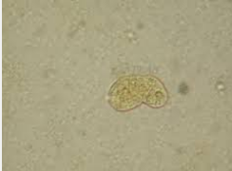
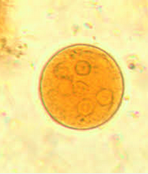
Trophozoites
Cyst

Slide 6
Pathogenesis
It causes amoebic dysentry or amoebiasis
Mode of transmission
- ingestion of infective cyst in food, water contaminated with sewage or from hands contaminated with sewage or faeces.
Flies feeding on faeces containing cysts may also transmit by contaminating foods.
Anal oral transmission may also occur among homosexuals
(There is no animal reservior)

Slide 7
Life cycle
Life cycle is completed in a single host human.
After ingestion of contaminated food and water, the infective form i.e. cyst undergo excystment in small intestine.
This excystment liberates 4 nuclei which gives rise to 8 nuclei and forms 8 trophozoites.
Theses trophozoites invade the colonic epithelium and secrets the enzymes that cause localized necrosis, little inflammation occur at a site.

Slide 8
Contd....
As the lesions reaches the muscularis layer , a typhical tear drop ulcer is form that can undermines and destroy large area of intestinal epithelium.
Progession into submucosa leads to invasion of portal circulation by the trpophozoites.
As the result some trophozoites may also travel to liver and cause amoebic liver abscess and from liver it may reach lungs, brain, spleen through circulation (extra intestinal amoebiasis)
During unfavourable condition, the trophozoites undergo encystment forming quadrinucleated cyst which are infective form and is passed into the stool

Slide 9
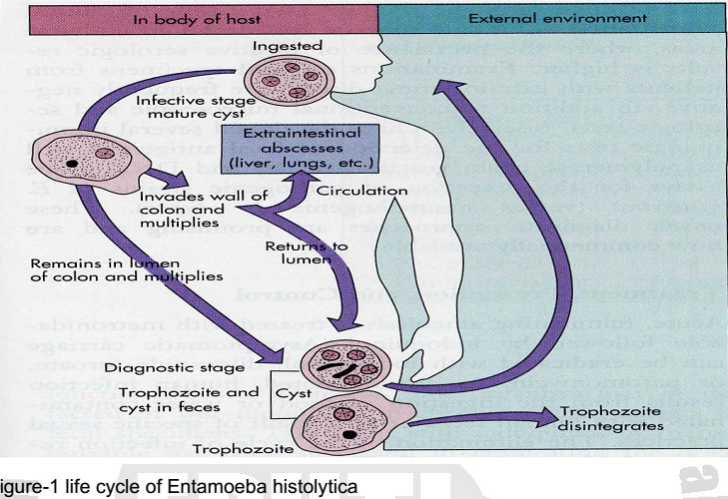
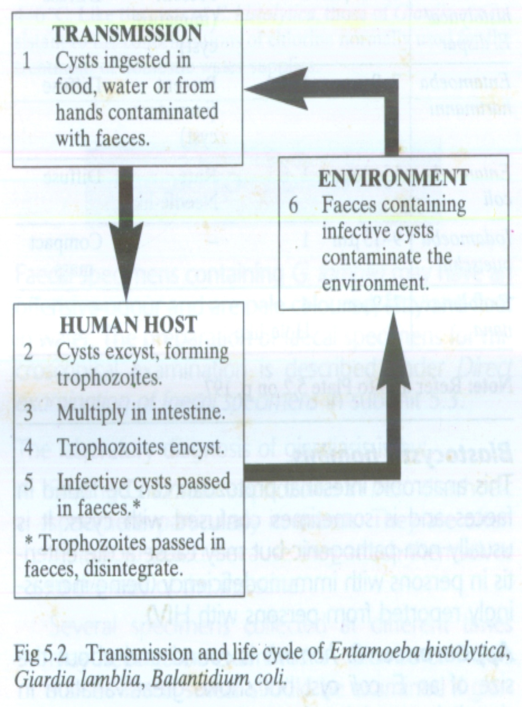

Slide 10
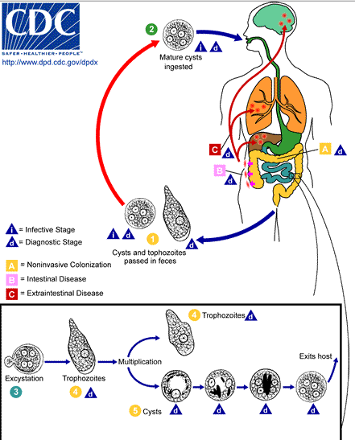

Slide 11
Clinical manifeststion
The incubation period can range from a few days to months or years, with 2–4 weeks being the most common for development of symptomatic non dysenteric disease.
Around 90% of infected people are asymptomatic carrier whose faeces contains cyst that can be transmitted.
Acute intestinal amoebiasis present as dysentry i.e. bloody, mucus containing diarrhoea followed by abdominal pain, flattulence and tenesmus.
Chronic amoebiasis is characterised by occasional diarrhoea, weight loss and fatigue.
Amoebic liver abscess is characterised by right upper quadrant pain, weight loss, fever and enlarged liver.

Slide 12
Laboratory Diagnosis
Sample: Stool
Macroscopic:watery ,blood stain stool. color of stool is dark red with offensive smell,( that’s why asking for color of stool while taking history from a patient, helps in diagnosis.
Microscopy
:-trophozoites showing motility in freshly passed stool
:-Cyst( wet mount in iodine,normal saline )

Slide 13
Sigmoidoscopy may reveal the characteristic ulcers, especially in more severe amoebiasis
Aspirates or biopsies can also be examined microscopically for trophozoites.
Serological test: Indirect haemagglutinationtest

Slide 14
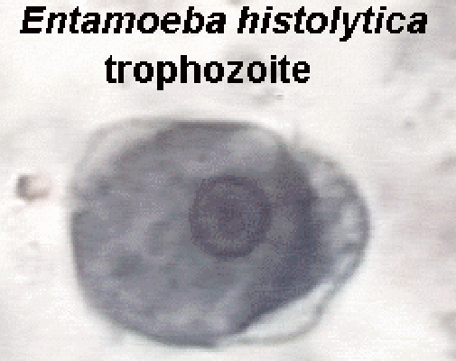
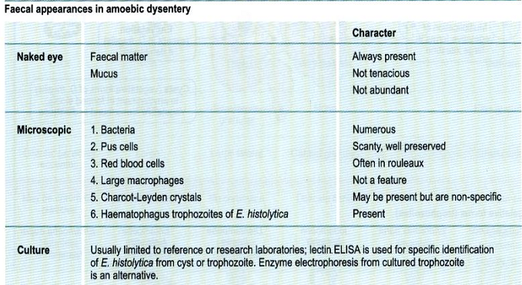
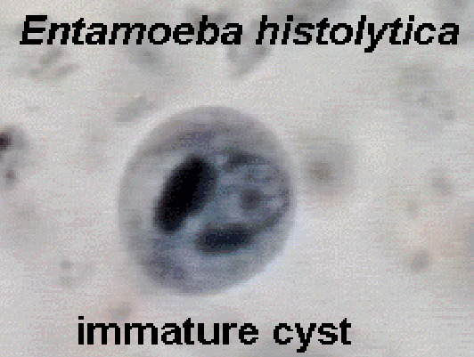
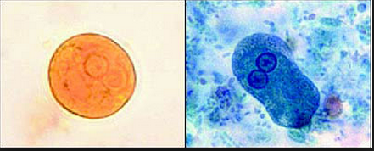
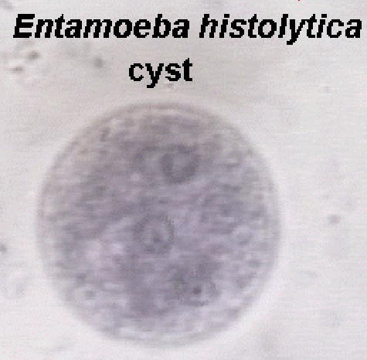

Slide 15
Treatment
Matronidazole plus iodoquinol.
Asypmtomatic cyst carrier should be treated with iodoquinol

Slide 16
Prevention
Introduction of adequate sanitation measures and education about the routes of transmission.
Avoid eating raw vegetables grown by sewerage irrigation and night soil.
Protect food from flies.
Effective sanitary disposal of faeces.
Protect water from fecal pollution.
Avoid human faeces as fertilizers.
Detection, isolation and treatement of carriers.

